Slide 1
History of Grades

Slide 2
Content
Grades of Assignments
Grades of Lessons
Grades of Tests & Quizzes
Gradebook

Slide 3
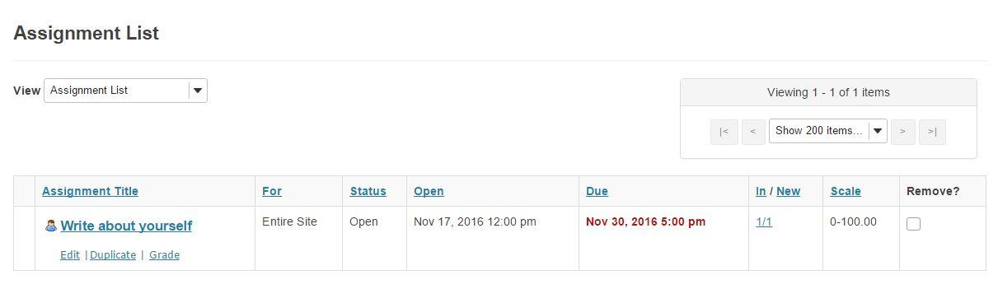
1. Grades of Assignments
When a joined user submitted the assignment which is created by admin or site owner, it will be informed as the following picture.

Slide 4
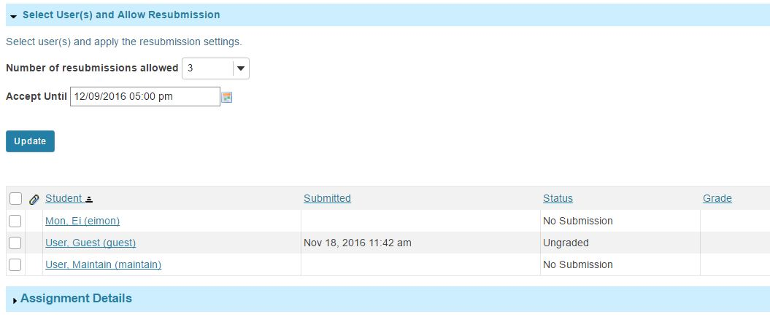
The user’s first submission and resubmission will be shown as the following pictures.

Slide 5
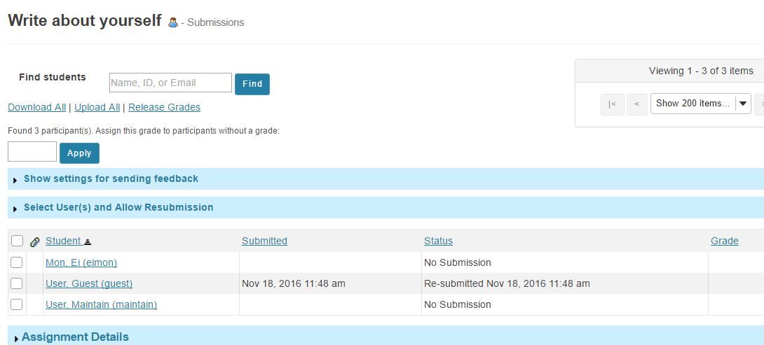

Slide 6
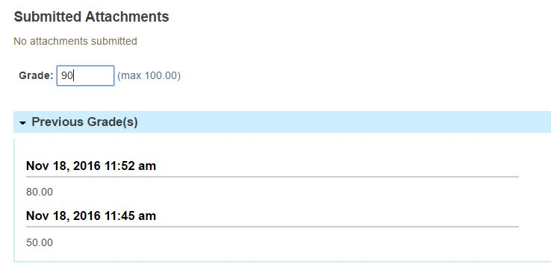
The record of submission and history of grades can be seen at Admin or Owner’s site as the following picture.

Slide 7
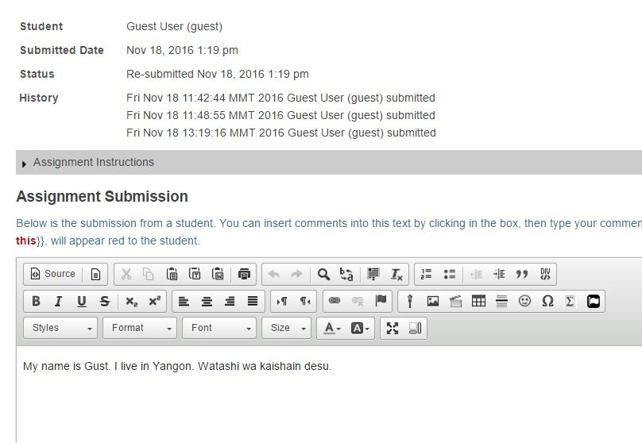

Slide 8
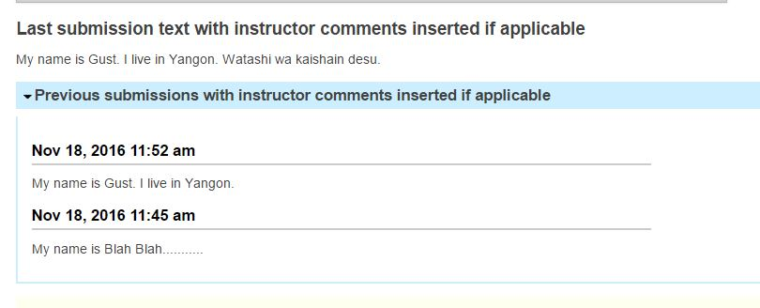
The record of submission and history of grades can be seen at user’s site as the following picture.

Slide 9
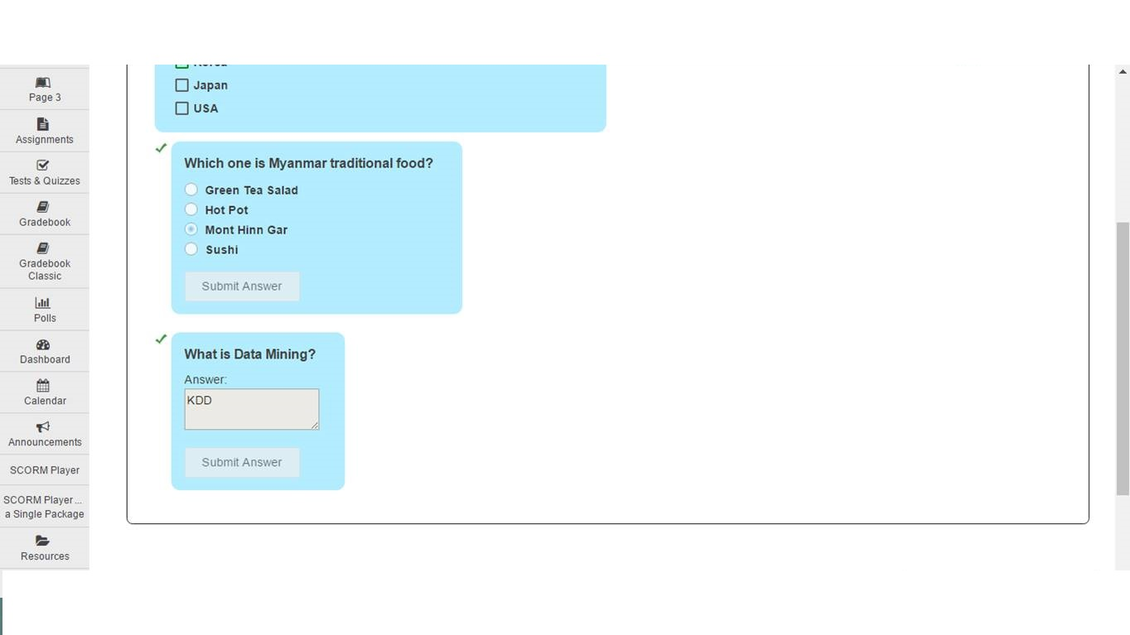
2. Grades of Lessons
The questions from Lessons cannot be submitted more than once.

Slide 10
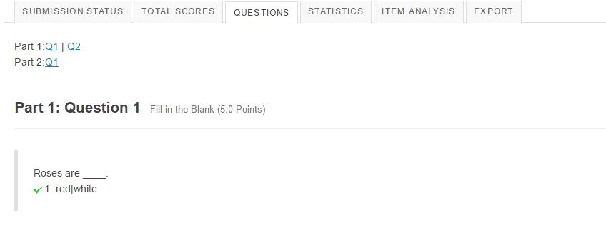
3. Grades of Tests & Quizzes
Tests & Quizzes is where the owner or admin can put multiple questions in one test.

Slide 11
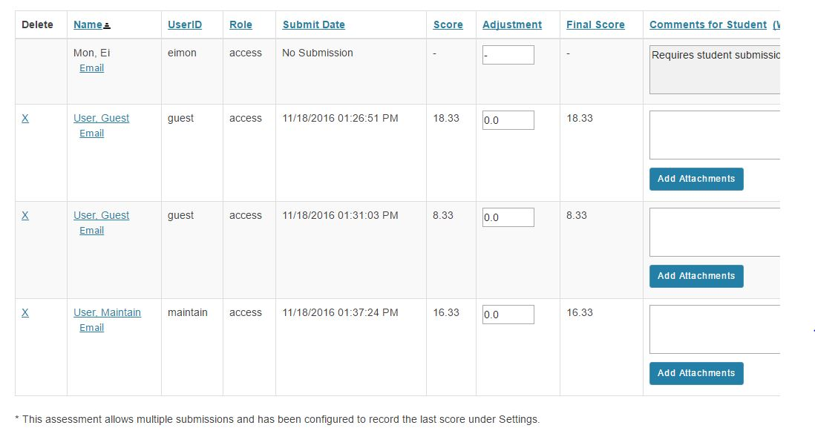
The owner or admin can see the history of recorded scores as the following picture.

Slide 12
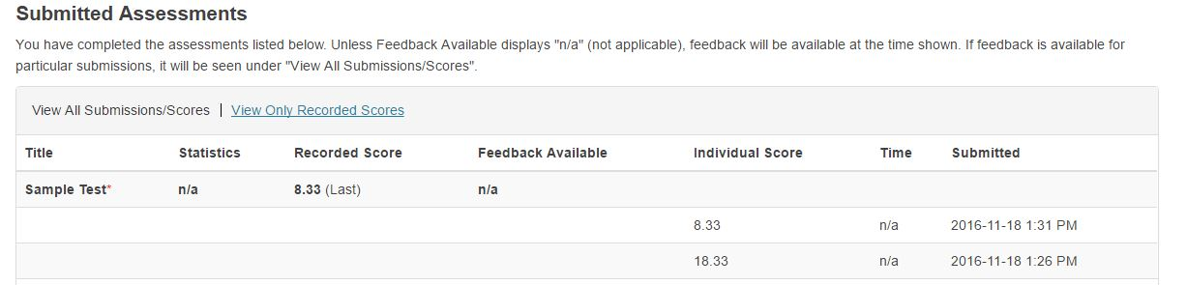
The joined user who took the test can see their scores as the following picture.

Slide 13
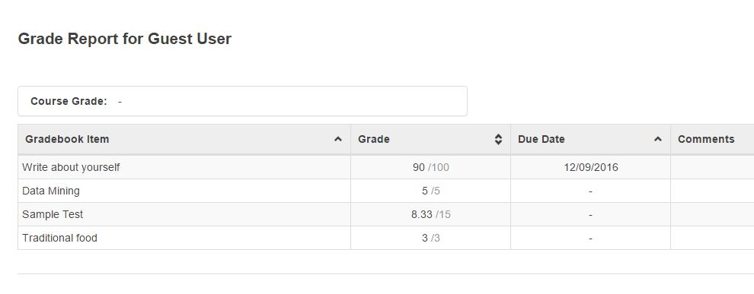
4. Gradebook
Though the history of scores are recorded and can be seen at the related tools, only the last recorded score will be shown in the gradebook.

Slide 14
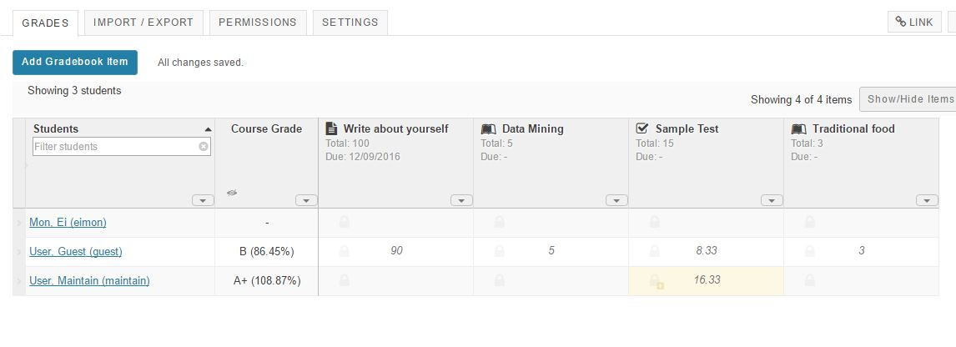
It’s the same with admin or owner’s side.

